Slide 1
Deep Learning

Slide 2
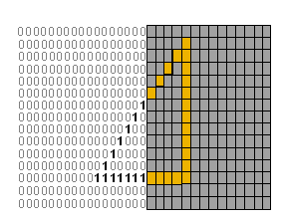
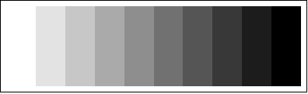
Images
0, 0.1, 0.2 0.9

Slide 3
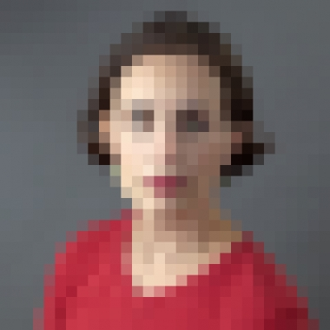
Image
Squares are pixels
30x30
Pixellated
Phone 12 MP 4000x3000
(R, G, B) = (256, 256, 256)
Or
Scaled [0,1]

Slide 4
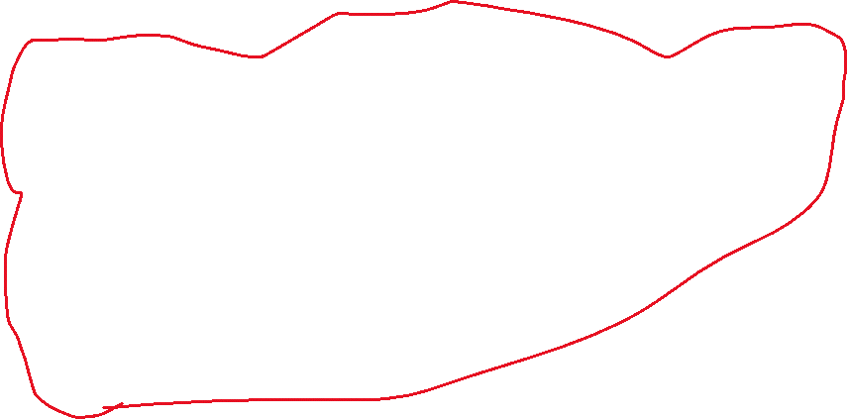
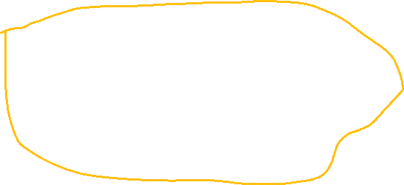
model = models.Sequential()
model.add(layers.Conv2D(32, (3, 3), activation='relu', input_shape=(150, 150, 3)))
model.add(layers.MaxPooling2D((2, 2)))
model.add(layers.Conv2D(64, (3, 3), activation='relu'))
model.add(layers.MaxPooling2D((2, 2)))
model.add(layers.Conv2D(128, (3, 3), activation='relu'))
model.add(layers.MaxPooling2D((2, 2)))
model.add(layers.Conv2D(128, (3, 3), activation='relu'))
model.add(layers.MaxPooling2D((2, 2)))
model.add(layers.Flatten())
model.add(layers.Dense(512, activation='relu'))
model.add(layers.Dense(1, activation='sigmoid'))
Feature Detector
Feedforward Network

